Slide 1

Housing Price Analysis
Tianyue yang
nick ayvazian
James Richards
Alex Gainer

Slide 2
Data Sources
Zillow CSV:
https://www.zillow.com/research/data/
Zillow Home Value Index – “A smoothed, seasonally adjusted measure of the typical home value and market changes across a given region and housing type (at zipcode level).”
Data ranges from 1996 to 2021

Slide 3
Data Sources
Census CSV:
From class activity 06-Python-APIs\3\Activities\08-Ins_Census\Solved\CensusData.csv
2020 Census data by zipcode

Slide 4
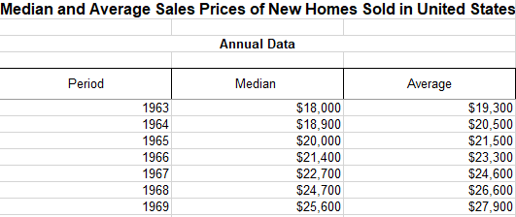
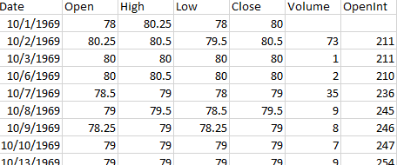
Data Sources
Median and Average Sale Price of Houses Sold (1963 – Present) – Census.gov
Historical S&P500 and Lumber Futures Prices - https://stooq.com/

Slide 5
Data Cleaning
Data filtering
Split data to metro data and suburban data by filtering on ‘Metro’ column in the Zillow data source
For house value and demographic correlation analysis, filter data by ‘2021-03-31’ to pull the latest data available.
For historical housing value analysis, keep all dates from 1996 – 2021, and transpose data from columns to rows
Data merging
Merged census data and Zillow data by zipcode
Merged historical data sources by time
Data cleansing
For both metro and suburban data, there is -666666666 household income value, removed rows contain this data
Generate CSV file
Output csv files

Slide 6
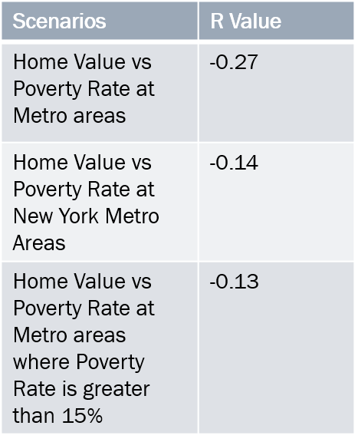
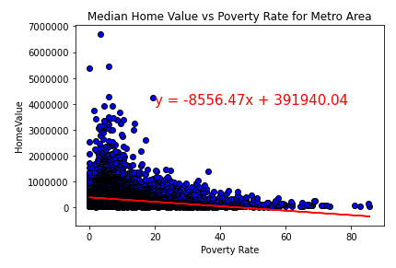
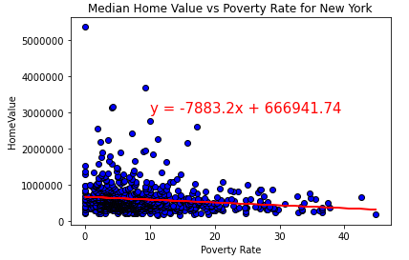
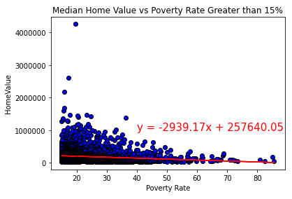
Home Value vs Poverty Rate
Linear Regression Analysis:
Observations:
Home Value and poverty rate at Metro areas in the US have a low degree of negative correlation.
In New York, the correlation is negligible since it is below 0.2.
Zipcode with poverty rate greater than 15% also has a negligible correlation with Home Values

Slide 7
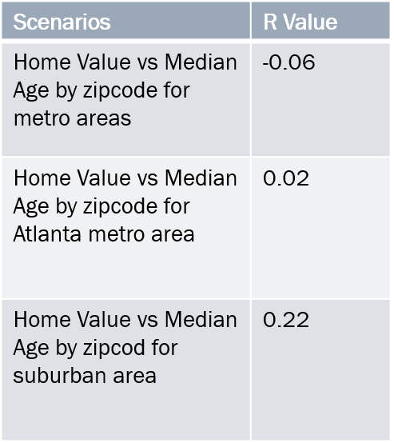
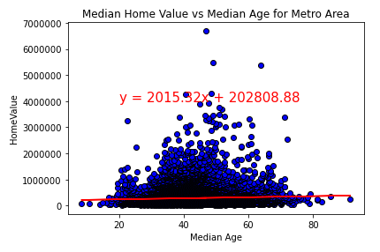
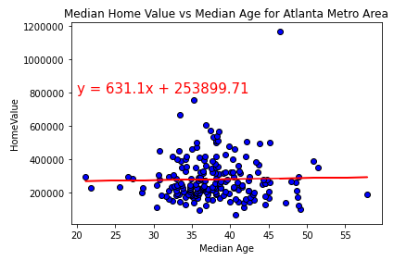
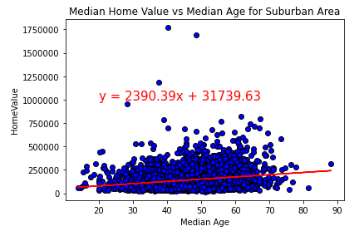
Home Value vs Median Age
Linear regression analysis:
Observations:
Home Value and median age at Metro areas in the US doesn’t show any correlation, and for Atlanta metro area, it doesn’t have any correlation neither.
For suburban area, it has a very low degree of positive correlation
The bell curve indicates most zipcode has residents with median age between 30 – 60, and in this age group, it has a big range of house value.

Slide 8
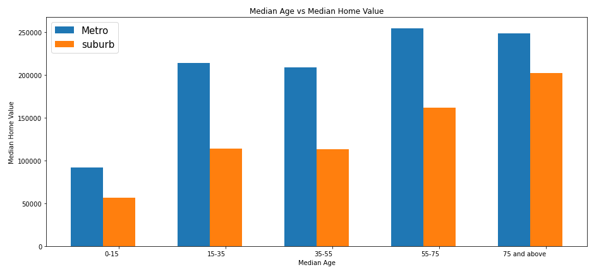
Median Age vs Home Value
Median home value increase as age goes up
For metro area, age 55-75 and 75 above have similar median home value,
For suburban area, 75 and above has higher median home value then 55-75 age group

Slide 9
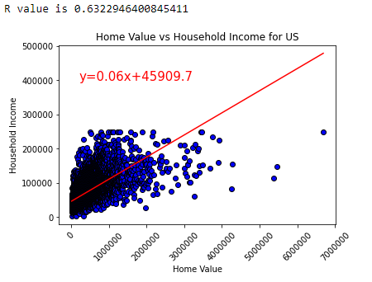
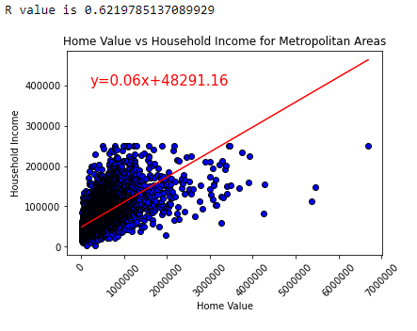
Home Value vs Income
As household income increase, home values also increase

Slide 10
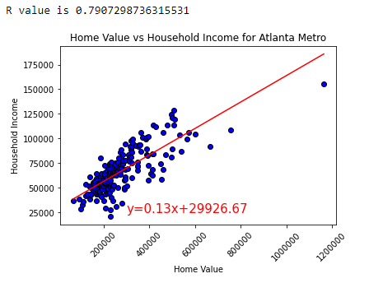
Home Value vs Income
As household income increase, home values also increase
Positive correlation for metro Atlanta area with stronger correlation coefficient

Slide 11
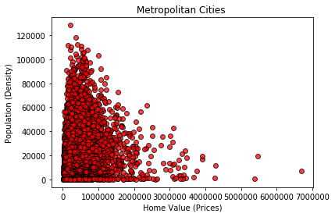
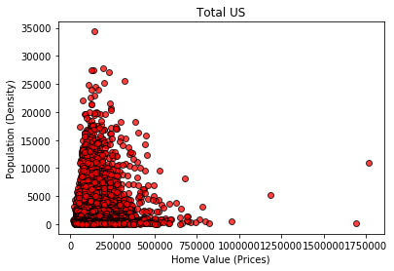
Home Value vs Population Density
Metro population density shows that the higher
the population, the higher the housing prices.
Suburban population density shows that the
lower the population, the lower the housing prices.

Slide 12
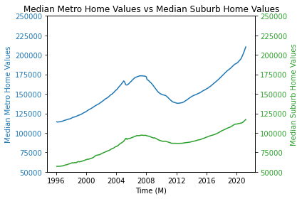
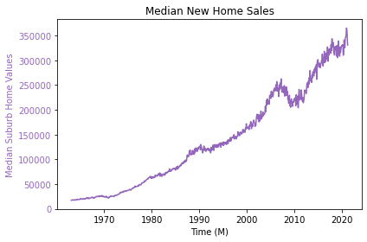
Historical Home Value Trends

Slide 13
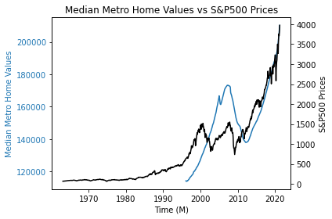
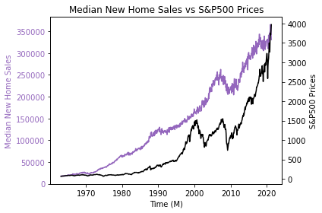
Historical Home Value Trends

Slide 14
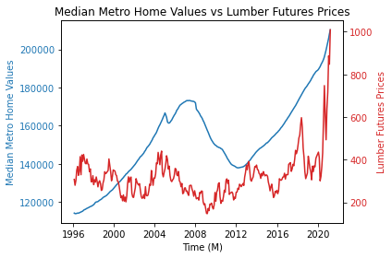
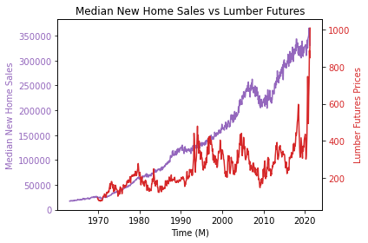
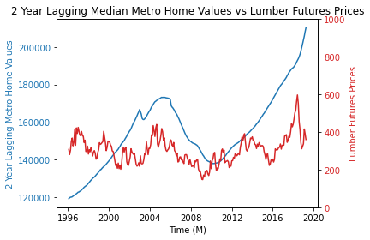
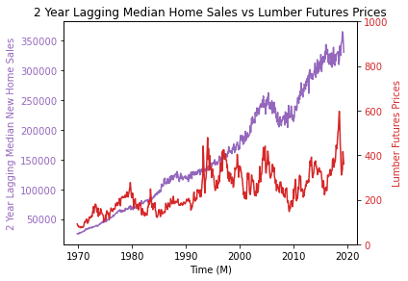

Slide 15
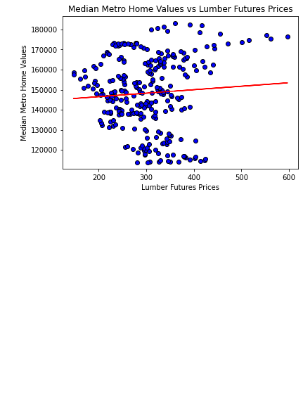
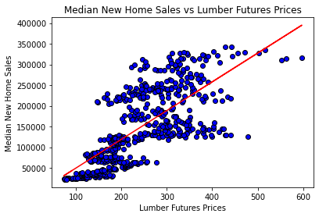
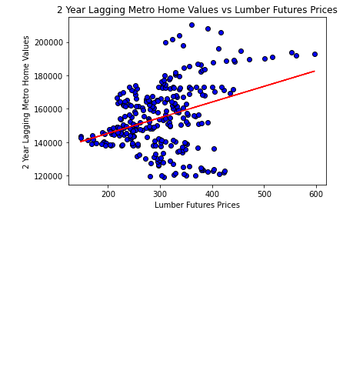
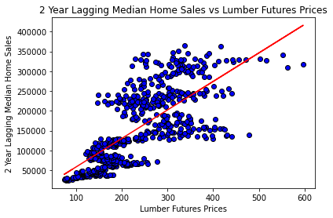

Slide 16
Thank you!
Any Questions?

